Slide 1

CSE- 208
Algorithms Lab
Lab: 10
Dynamic Programming
Fahad Ahmed
Lecturer, Dept. of CSE
E-mail: fahadahmed@uap-bd.edu

Slide 2
Task-10
Problem:
Implement the following algorithm using Dynamic Programming:
0-1 Knapsack Problem
Unbounded Knapsack

Slide 3


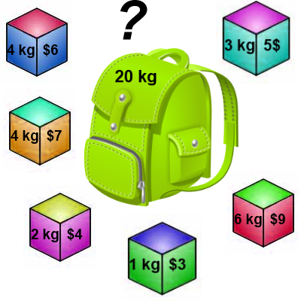
0-1 Knapsack

Slide 4
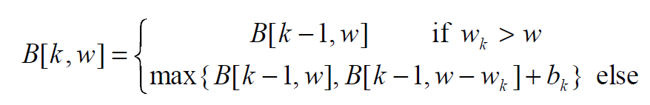
Knapsack 0-1 Problem – Recursive Formula
The best subset of S_{k} that has the total weight w, either contains item k or not.
First case: w_{k} > w
Item k can’t be part of the solution! If it was the total weight would be > w, which is unacceptable.
Second case: w_{k} ≤ w
Then the item k can be in the solution, and we choose the case with greater value.

Slide 5
Knapsack 0-1 Problem
Consider the problem having weights and profits are:
Weights: {2, 3, 4, 5}
Profits: {3, 4, 5, 6}
The weight of the knapsack is 5 kg
The number of items is 4

Slide 6
Knapsack 0-1 Example
Weights: {2, 3, 4, 5}
Profits: {3, 4, 5, 6}
i / w | 0 | 1 | 2 | 3 | 4 | 5
0 | 0 | 0 | 0 | 0 | 0 | 0
1 | 0
2 | 0
3 | 0
4 | 0
// Initialize the base cases
for w = 0 to W
B[0,w] = 0
for i = 1 to n
B[i,0] = 0

Slide 7
Knapsack 0-1 Example
Items:
1: (2,3)
2: (3,4)
3: (4,5)
4: (5,6)
Weights: {2, 3, 4, 5}
Profits: {3, 4, 5, 6}
i / w | 0 | 1 | 2 | 3 | 4 | 5
0 | 0 | 0 | 0 | 0 | 0 | 0
1 | 0
2 | 0
3 | 0
4 | 0
i / w | 0 | 1 | 2 | 3 | 4 | 5
0 | 0 | 0 | 0 | 0 | 0 | 0
1 | 0 | 0
2 | 0
3 | 0
4 | 0
i = 1
v_{i} = 3
w_{i} = 2
w = 1
w-w_{i} = -1

Slide 8
Knapsack 0-1 Example
Items:
1: (2,3)
2: (3,4)
3: (4,5)
4: (5,6)
Weights: {2, 3, 4, 5}
Profits: {3, 4, 5, 6}
i / w | 0 | 1 | 2 | 3 | 4 | 5
0 | 0 | 0 | 0 | 0 | 0 | 0
1 | 0 | 0
2 | 0
3 | 0
4 | 0
i / w | 0 | 1 | 2 | 3 | 4 | 5
0 | 0 | 0 | 0 | 0 | 0 | 0
1 | 0 | 0 | 3
2 | 0
3 | 0
4 | 0
i = 1
v_{i} = 3
w_{i} = 2
w = 2
w-w_{i} = 0

Slide 9
Knapsack 0-1 Example
Items:
1: (2,3)
2: (3,4)
3: (4,5)
4: (5,6)
Weights: {2, 3, 4, 5}
Profits: {3, 4, 5, 6}
i / w | 0 | 1 | 2 | 3 | 4 | 5
0 | 0 | 0 | 0 | 0 | 0 | 0
1 | 0 | 0 | 3
2 | 0
3 | 0
4 | 0
i / w | 0 | 1 | 2 | 3 | 4 | 5
0 | 0 | 0 | 0 | 0 | 0 | 0
1 | 0 | 0 | 3 | 3
2 | 0
3 | 0
4 | 0
i = 1
v_{i} = 3
w_{i} = 2
w = 3
w-w_{i} = 1

Slide 10
Knapsack 0-1 Example
Items:
1: (2,3)
2: (3,4)
3: (4,5)
4: (5,6)
Weights: {2, 3, 4, 5}
Profits: {3, 4, 5, 6}
i / w | 0 | 1 | 2 | 3 | 4 | 5
0 | 0 | 0 | 0 | 0 | 0 | 0
1 | 0 | 0 | 3 | 3
2 | 0
3 | 0
4 | 0
i / w | 0 | 1 | 2 | 3 | 4 | 5
0 | 0 | 0 | 0 | 0 | 0 | 0
1 | 0 | 0 | 3 | 3 | 3
2 | 0
3 | 0
4 | 0
i = 1
v_{i} = 3
w_{i} = 2
w = 4
w-w_{i} = 2

Slide 11
Knapsack 0-1 Example
Items:
1: (2,3)
2: (3,4)
3: (4,5)
4: (5,6)
Weights: {2, 3, 4, 5}
Profits: {3, 4, 5, 6}
i / w | 0 | 1 | 2 | 3 | 4 | 5
0 | 0 | 0 | 0 | 0 | 0 | 0
1 | 0 | 0 | 3 | 3 | 3
2 | 0
3 | 0
4 | 0
i / w | 0 | 1 | 2 | 3 | 4 | 5
0 | 0 | 0 | 0 | 0 | 0 | 0
1 | 0 | 0 | 3 | 3 | 3 | 3
2 | 0
3 | 0
4 | 0
i = 1
v_{i} = 3
w_{i} = 2
w = 5
w-w_{i} = 3

Slide 12
Knapsack 0-1 Example
Items:
1: (2,3)
2: (3,4)
3: (4,5)
4: (5,6)
Weights: {2, 3, 4, 5}
Profits: {3, 4, 5, 6}
i / w | 0 | 1 | 2 | 3 | 4 | 5
0 | 0 | 0 | 0 | 0 | 0 | 0
1 | 0 | 0 | 3 | 3 | 3 | 3
2 | 0
3 | 0
4 | 0
i / w | 0 | 1 | 2 | 3 | 4 | 5
0 | 0 | 0 | 0 | 0 | 0 | 0
1 | 0 | 0 | 3 | 3 | 3 | 3
2 | 0 | 0
3 | 0
4 | 0
i = 2
v_{i} = 4
w_{i} = 3
w = 1
w-w_{i} = -2

Slide 13
Knapsack 0-1 Example
Items:
1: (2,3)
2: (3,4)
3: (4,5)
4: (5,6)
Weights: {2, 3, 4, 5}
Profits: {3, 4, 5, 6}
i / w | 0 | 1 | 2 | 3 | 4 | 5
0 | 0 | 0 | 0 | 0 | 0 | 0
1 | 0 | 0 | 3 | 3 | 3 | 3
2 | 0 | 0
3 | 0
4 | 0
i / w | 0 | 1 | 2 | 3 | 4 | 5
0 | 0 | 0 | 0 | 0 | 0 | 0
1 | 0 | 0 | 3 | 3 | 3 | 3
2 | 0 | 0 | 3
3 | 0
4 | 0
i = 2
v_{i} = 4
w_{i} = 3
w = 2
w-w_{i} = -1

Slide 14
Knapsack 0-1 Example
Items:
1: (2,3)
2: (3,4)
3: (4,5)
4: (5,6)
Weights: {2, 3, 4, 5}
Profits: {3, 4, 5, 6}
i / w | 0 | 1 | 2 | 3 | 4 | 5
0 | 0 | 0 | 0 | 0 | 0 | 0
1 | 0 | 0 | 3 | 3 | 3 | 3
2 | 0 | 0 | 3
3 | 0
4 | 0
i / w | 0 | 1 | 2 | 3 | 4 | 5
0 | 0 | 0 | 0 | 0 | 0 | 0
1 | 0 | 0 | 3 | 3 | 3 | 3
2 | 0 | 0 | 3 | 4
3 | 0
4 | 0
i = 2
v_{i} = 4
w_{i} = 3
w = 3
w-w_{i} = 0

Slide 15
Knapsack 0-1 Example
Items:
1: (2,3)
2: (3,4)
3: (4,5)
4: (5,6)
Weights: {2, 3, 4, 5}
Profits: {3, 4, 5, 6}
i / w | 0 | 1 | 2 | 3 | 4 | 5
0 | 0 | 0 | 0 | 0 | 0 | 0
1 | 0 | 0 | 3 | 3 | 3 | 3
2 | 0 | 0 | 3 | 4
3 | 0
4 | 0
i / w | 0 | 1 | 2 | 3 | 4 | 5
0 | 0 | 0 | 0 | 0 | 0 | 0
1 | 0 | 0 | 3 | 3 | 3 | 3
2 | 0 | 0 | 3 | 4 | 4
3 | 0
4 | 0
i = 2
v_{i} = 4
w_{i} = 3
w = 4
w-w_{i} = 1

Slide 16
Knapsack 0-1 Example
Items:
1: (2,3)
2: (3,4)
3: (4,5)
4: (5,6)
Weights: {2, 3, 4, 5}
Profits: {3, 4, 5, 6}
i / w | 0 | 1 | 2 | 3 | 4 | 5
0 | 0 | 0 | 0 | 0 | 0 | 0
1 | 0 | 0 | 3 | 3 | 3 | 3
2 | 0 | 0 | 3 | 4 | 4
3 | 0
4 | 0
i / w | 0 | 1 | 2 | 3 | 4 | 5
0 | 0 | 0 | 0 | 0 | 0 | 0
1 | 0 | 0 | 3 | 3 | 3 | 3
2 | 0 | 0 | 3 | 4 | 4 | 7
3 | 0
4 | 0
i = 2
v_{i} = 4
w_{i} = 3
w = 5
w-w_{i} = 2

Slide 17
Knapsack 0-1 Example
Items:
1: (2,3)
2: (3,4)
3: (4,5)
4: (5,6)
Weights: {2, 3, 4, 5}
Profits: {3, 4, 5, 6}
i / w | 0 | 1 | 2 | 3 | 4 | 5
0 | 0 | 0 | 0 | 0 | 0 | 0
1 | 0 | 0 | 3 | 3 | 3 | 3
2 | 0 | 0 | 3 | 4 | 4 | 7
3 | 0
4 | 0
i / w | 0 | 1 | 2 | 3 | 4 | 5
0 | 0 | 0 | 0 | 0 | 0 | 0
1 | 0 | 0 | 3 | 3 | 3 | 3
2 | 0 | 0 | 3 | 4 | 4 | 7
3 | 0 | 0 | 3 | 4
4 | 0
i = 3
v_{i} = 5
w_{i} = 4
w = 1..3
w-w_{i} = -3..-1

Slide 18
Knapsack 0-1 Example
Items:
1: (2,3)
2: (3,4)
3: (4,5)
4: (5,6)
Weights: {2, 3, 4, 5}
Profits: {3, 4, 5, 6}
i / w | 0 | 1 | 2 | 3 | 4 | 5
0 | 0 | 0 | 0 | 0 | 0 | 0
1 | 0 | 0 | 3 | 3 | 3 | 3
2 | 0 | 0 | 3 | 4 | 4 | 7
3 | 0 | 0 | 3 | 4
4 | 0
i / w | 0 | 1 | 2 | 3 | 4 | 5
0 | 0 | 0 | 0 | 0 | 0 | 0
1 | 0 | 0 | 3 | 3 | 3 | 3
2 | 0 | 0 | 3 | 4 | 4 | 7
3 | 0 | 0 | 3 | 4 | 5
4 | 0
i = 3
v_{i} = 5
w_{i} = 4
w = 4
w-w_{i} = 0

Slide 19
Knapsack 0-1 Example
Items:
1: (2,3)
2: (3,4)
3: (4,5)
4: (5,6)
Weights: {2, 3, 4, 5}
Profits: {3, 4, 5, 6}
i / w | 0 | 1 | 2 | 3 | 4 | 5
0 | 0 | 0 | 0 | 0 | 0 | 0
1 | 0 | 0 | 3 | 3 | 3 | 3
2 | 0 | 0 | 3 | 4 | 4 | 7
3 | 0 | 0 | 3 | 4 | 5
4 | 0
i / w | 0 | 1 | 2 | 3 | 4 | 5
0 | 0 | 0 | 0 | 0 | 0 | 0
1 | 0 | 0 | 3 | 3 | 3 | 3
2 | 0 | 0 | 3 | 4 | 4 | 7
3 | 0 | 0 | 3 | 4 | 5 | 7
4 | 0
i = 3
v_{i} = 5
w_{i} = 4
w = 5
w-w_{i} = 1

Slide 20
Knapsack 0-1 Example
Items:
1: (2,3)
2: (3,4)
3: (4,5)
4: (5,6)
Weights: {2, 3, 4, 5}
Profits: {3, 4, 5, 6}
i / w | 0 | 1 | 2 | 3 | 4 | 5
0 | 0 | 0 | 0 | 0 | 0 | 0
1 | 0 | 0 | 3 | 3 | 3 | 3
2 | 0 | 0 | 3 | 4 | 4 | 7
3 | 0 | 0 | 3 | 4 | 5 | 7
4 | 0
i / w | 0 | 1 | 2 | 3 | 4 | 5
0 | 0 | 0 | 0 | 0 | 0 | 0
1 | 0 | 0 | 3 | 3 | 3 | 3
2 | 0 | 0 | 3 | 4 | 4 | 7
3 | 0 | 0 | 3 | 4 | 5 | 7
4 | 0 | 0 | 3 | 4 | 5
i = 4
v_{i} = 6
w_{i} = 5
w = 1..4
w-w_{i} = -4..-1

Slide 21
Knapsack 0-1 Example
Items:
1: (2,3)
2: (3,4)
3: (4,5)
4: (5,6)
Weights: {2, 3, 4, 5}
Profits: {3, 4, 5, 6}
i / w | 0 | 1 | 2 | 3 | 4 | 5
0 | 0 | 0 | 0 | 0 | 0 | 0
1 | 0 | 0 | 3 | 3 | 3 | 3
2 | 0 | 0 | 3 | 4 | 4 | 7
3 | 0 | 0 | 3 | 4 | 5 | 7
4 | 0 | 0 | 3 | 4 | 5
i / w | 0 | 1 | 2 | 3 | 4 | 5
0 | 0 | 0 | 0 | 0 | 0 | 0
1 | 0 | 0 | 3 | 3 | 3 | 3
2 | 0 | 0 | 3 | 4 | 4 | 7
3 | 0 | 0 | 3 | 4 | 5 | 7
4 | 0 | 0 | 3 | 4 | 5 | 7
i = 4
v_{i} = 6
w_{i} = 5
w = 5
w-w_{i} = 0

Slide 22
Knapsack 0-1 Example
Items:
1: (2,3)
2: (3,4)
3: (4,5)
4: (5,6)
Weights: {2, 3, 4, 5}
Profits: {3, 4, 5, 6}
i / w | 0 | 1 | 2 | 3 | 4 | 5
0 | 0 | 0 | 0 | 0 | 0 | 0
1 | 0 | 0 | 3 | 3 | 3 | 3
2 | 0 | 0 | 3 | 4 | 4 | 7
3 | 0 | 0 | 3 | 4 | 5 | 7
4 | 0 | 0 | 3 | 4 | 5 | 7
We’re DONE!!
The max possible value that can be carried in this knapsack is $7

Slide 23
Knapsack 0-1 Algorithm
This algorithm only finds the max possible value that can be carried in the knapsack
The value in dp[n,W]
To know the items that make this maximum value, we need to trace back through the table.

Slide 24
Knapsack 0-1 Algorithm Finding the Items
Let i = n and k = W
if dp[i, k] ≠ dp[i-1, k] then
mark the i^{th} item as in the knapsack
i = i-1, cpt = cpt-w_{i}
else
i = i-1 // Assume the i^{th} item is not in the knapsack
// Could it be in the optimally packed knapsack?

Slide 25
Knapsack 0-1 Algorithm Finding the Items
Items:
1: (2,3)
2: (3,4)
3: (4,5)
4: (5,6)
Knapsack:
i / w | 0 | 1 | 2 | 3 | 4 | 5
0 | 0 | 0 | 0 | 0 | 0 | 0
1 | 0 | 0 | 3 | 3 | 3 | 3
2 | 0 | 0 | 3 | 4 | 4 | 7
3 | 0 | 0 | 3 | 4 | 5 | 7
4 | 0 | 0 | 3 | 4 | 5 | 7
i = 4
k = 5
v_{i} = 6
w_{i} = 5
dp[i,k] = 7
dp[i-1,k] = 7

Slide 26
Knapsack 0-1 Algorithm Finding the Items
Items:
1: (2,3)
2: (3,4)
3: (4,5)
4: (5,6)
Knapsack:
i / w | 0 | 1 | 2 | 3 | 4 | 5
0 | 0 | 0 | 0 | 0 | 0 | 0
1 | 0 | 0 | 3 | 3 | 3 | 3
2 | 0 | 0 | 3 | 4 | 4 | 7
3 | 0 | 0 | 3 | 4 | 5 | 7
4 | 0 | 0 | 3 | 4 | 5 | 7
i = 3
k = 5
v_{i} = 5
w_{i} = 4
dp[i,k] = 7
dp[i-1,k] = 7

Slide 27
Knapsack 0-1 Algorithm Finding the Items
Items:
1: (2,3)
2: (3,4)
3: (4,5)
4: (5,6)
Knapsack:
Item 2
i / w | 0 | 1 | 2 | 3 | 4 | 5
0 | 0 | 0 | 0 | 0 | 0 | 0
1 | 0 | 0 | 3 | 3 | 3 | 3
2 | 0 | 0 | 3 | 4 | 4 | 7
3 | 0 | 0 | 3 | 4 | 5 | 7
4 | 0 | 0 | 3 | 4 | 5 | 7
i = 2
k = 5
v_{i} = 4
w_{i} = 3
dp[i,k] = 7
dp[i-1,k] = 3
k – w_{i} = 2

Slide 28
Knapsack 0-1 Algorithm Finding the Items
Items:
1: (2,3)
2: (3,4)
3: (4,5)
4: (5,6)
Knapsack:
Item 2
Item 1
i / w | 0 | 1 | 2 | 3 | 4 | 5
0 | 0 | 0 | 0 | 0 | 0 | 0
1 | 0 | 0 | 3 | 3 | 3 | 3
2 | 0 | 0 | 3 | 4 | 4 | 7
3 | 0 | 0 | 3 | 4 | 5 | 7
4 | 0 | 0 | 3 | 4 | 5 | 7
i = 1
k = 2
v_{i} = 3
w_{i} = 2
dp[i,k] = 3
dp[i-1,k] = 0
k – w_{i} = 0

Slide 29
Knapsack 0-1 Algorithm Finding the Items
Items:
1: (2,3)
2: (3,4)
3: (4,5)
4: (5,6)
Knapsack:
Item 2
Item 1
i / w | 0 | 1 | 2 | 3 | 4 | 5
0 | 0 | 0 | 0 | 0 | 0 | 0
1 | 0 | 0 | 3 | 3 | 3 | 3
2 | 0 | 0 | 3 | 4 | 4 | 7
3 | 0 | 0 | 3 | 4 | 5 | 7
4 | 0 | 0 | 3 | 4 | 5 | 7
i = 1
k = 2
v_{i} = 3
w_{i} = 2
dp[i,k] = 3
dp[i-1,k] = 0
k – w_{i} = 0
k = 0, so we’re DONE!
The optimal knapsack should contain:
Item 1 and Item 2

Slide 30
How to find the items that are in the sack?
while (n != 0)
{
if (dp[n][cpt] != dp[n - 1][cpt])
{
printf("\nPackage %d with Wt = %d and Val = %d\n",n, wt[n-1], val[n-1] );
cpt = cpt - wt[n-1];
}
n--;
}

Slide 31
Knapsack 0-1 Problem – Run Time
for w = 0 to W
dp[0,w] = 0
for i = 1 to n
[i,0] = 0
for i = 1 to n
for w = 0 to W
< the rest of the code >
What is the running time of this algorithm?
O(n*W) – of course, W can be mighty big
What is an analogy in world of sorting?
Remember that the brute-force algorithm takes: O(2^{n})
O(W)
O(n)
Repeat n times
O(W)

Slide 32
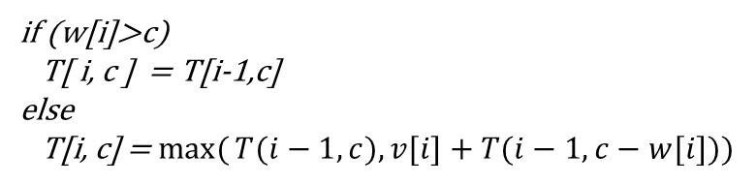
Knapsack simulation
Assume,
Sack capacity, C = 10
Available Items
V = 7 2 1 6 12
W =3 1 2 4 6
if (w[i]>c)
T[ i, c ] = T[i-1,c]
else
T[i, c] = $\max{(}T(i−1, c),v[i]+T(i−1, c−w[i]))$
i | v_{i} | w_{i} | 0 | 1 | 2 | 3 | 4 | 5 | 6 | 7 | 8 | 9 | 10
0 | 0 | 0
1 | 2 | 1
2 | 1 | 2
3 | 7 | 3 |  |  |  |  |  |  |  | A
4 | 6 | 4
5 | 12 | 6
Capacity
Any cell in the table represents the maximum value attained by choosing items from i items (not i^{th} ) in a sack of capacity listed in the header. For example, the cell with value “A” represents that we can add items of total value “A” from 3 items and with a sack capacity=7 which is represented as T[3,7] = A

Slide 33
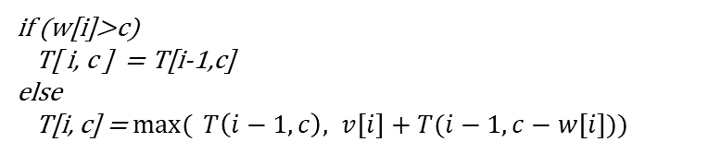
Knapsack simulation
Assume,
Sack capacity, C = 10
Available Items
V = 7 2 1 6 12
W =3 1 2 4 6
if (w[i]>c)
T[ i, c ] = T[i-1,c]
else
T[i, c] = $\max{( }T\left(i−1, c\right), v[i]+T(i−1, c−w[i]))$
i | v_{i} | w_{i} | 0 | 1 | 2 | 3 | 4 | 5 | 6 | 7 | 8 | 9 | 10
0 | 0 | 0
1 | 2 | 1
2 | 1 | 2
3 | 7 | 3
4 | 6 | 4
5 | 12 | 6
Capacity

Slide 34
Knapsack simulation
Assume,
Sack capacity, C = 10
Available Items
V = 7 2 1 6 12
W =3 1 2 4 6
if (w[i]>c)
T[ i, c ] = T[i-1,c]
else
T[i, c] = $\max{(} T\left(i−1, c\right), v[i]+T(i−1, c−w[i]))$
i | v_{i} | w_{i} | 0 | 1 | 2 | 3 | 4 | 5 | 6 | 7 | 8 | 9 | 10
0 | 0 | 0 | 0 | 0 | 0 | 0 | 0 | 0 | 0 | 0 | 0 | 0 | 0
1 | 2 | 1
2 | 1 | 2
3 | 7 | 3
4 | 6 | 4
5 | 12 | 6
Capacity
If i=0, no items are available, to put to the sack, the maximum value we can attain is 0.

Slide 35
Knapsack simulation
Assume,
Sack capacity, C = 10
Available Items
V = 7 2 1 6 12
W =3 1 2 4 6
if (w[i]>c)
T[ i, c ] = T[i-1,c]
else
T[i, c] = $\max{(} T\left(i−1, c\right), v[i]+T(i−1, c−w[i]))$
i | v_{i} | w_{i} | 0 | 1 | 2 | 3 | 4 | 5 | 6 | 7 | 8 | 9 | 10
0 | 0 | 0 | 0 | 0 | 0 | 0 | 0 | 0 | 0 | 0 | 0 | 0 | 0
1 | 2 | 1 | 0
2 | 1 | 2 | 0
3 | 7 | 3 | 0
4 | 6 | 4 | 0
5 | 12 | 6 | 0
Capacity
If bag capacity is 0, we can’t add anything into the sack. So, attained value is 0.

Slide 36
Knapsack simulation
Assume,
Sack capacity, C = 10
Available Items
V = 7 2 1 6 12
W =3 1 2 4 6
if (w[i]>c)
T[ i, c ] = T[i-1,c]
else
T[i, c] = $\max{(} T\left(i−1, c\right), v[i]+T(i−1, c−w[i]))$
i | v_{i} | w_{i} | 0 | 1 | 2 | 3 | 4 | 5 | 6 | 7 | 8 | 9 | 10
0 | 0 | 0 | 0 | 0 | 0 | 0 | 0 | 0 | 0 | 0 | 0 | 0 | 0
1 | 2 | 1 | 0
2 | 1 | 2 | 0
3 | 7 | 3 | 0
4 | 6 | 4 | 0
5 | 12 | 6 | 0
Capacity
T[1,1] = Max(T[1-1,1], v₁ + T[1-1,1-1])
= Max( T[0,1], 2 + T[0,0])
= Max(0, 2+0) = 2

Slide 37
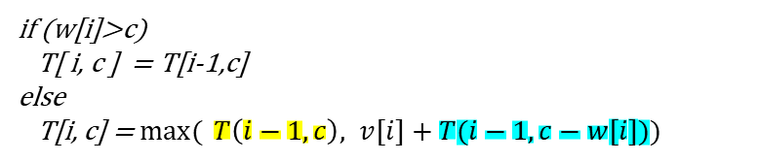
Knapsack simulation
Assume,
Sack capacity, C = 10
Available Items
V = 7 2 1 6 12
W =3 1 2 4 6
if (w[i]>c)
T[ i, c ] = T[i-1,c]
else
T[i, c] = $\max{(} T\left(i−1, c\right), v[i]+T(i−1, c−w[i]))$
i | v_{i} | w_{i} | 0 | 1 | 2 | 3 | 4 | 5 | 6 | 7 | 8 | 9 | 10
0 | 0 | 0 | 0 | 0 | 0 | 0 | 0 | 0 | 0 | 0 | 0 | 0 | 0
1 | 2 | 1 | 0
2 | 1 | 2 | 0
3 | 7 | 3 | 0
4 | 6 | 4 | 0
5 | 12 | 6 | 0
Capacity
T[1,1] = Max(T[1-1,1], v₁ + T[1-1,1-1])
= Max( T[0,1], 2 + T[0,0])
= Max(0, 2+0) = 2

Slide 38
Knapsack simulation
Assume,
Sack capacity, C = 10
Available Items
V = 7 2 1 6 12
W =3 1 2 4 6
if (w[i]>c)
T[ i, c ] = T[i-1,c]
else
T[i, c] = $\max{(} T\left(i−1, c\right), v[i]+T(i−1, c−w[i]))$
i | v_{i} | w_{i} | 0 | 1 | 2 | 3 | 4 | 5 | 6 | 7 | 8 | 9 | 10
0 | 0 | 0 | 0 | 0 | 0 | 0 | 0 | 0 | 0 | 0 | 0 | 0 | 0
1 | 2 | 1 | 0 | 2
2 | 1 | 2 | 0
3 | 7 | 3 | 0
4 | 6 | 4 | 0
5 | 12 | 6 | 0
Capacity
T[1,1] = Max(T[1-1,1], v₁ + T[1-1,1-1])
= Max( T[0,1], 2 + T[0,0])
= Max(0, 2+0) = 2

Slide 39
Knapsack simulation
Assume,
Sack capacity, C = 10
Available Items
V = 7 2 1 6 12
W =3 1 2 4 6
if (w[i]>c)
T[ i, c ] = T[i-1,c]
else
T[i, c] = $\max{( }T\left(i−1, c\right), v[i]+T(i−1, c−w[i]))$
i | v_{i} | w_{i} | 0 | 1 | 2 | 3 | 4 | 5 | 6 | 7 | 8 | 9 | 10
0 | 0 | 0 | 0 | 0 | 0 | 0 | 0 | 0 | 0 | 0 | 0 | 0 | 0
1 | 2 | 1 | 0 | 2 | 2
2 | 1 | 2 | 0
3 | 7 | 3 | 0
4 | 6 | 4 | 0
5 | 12 | 6 | 0
Capacity
Going w₁ cell back
T[1,2] = Max(T[1-1,1], v₁ + T[1-1,2-1])
= Max( T[0,1], 2 + T[0,1])
= Max(0, 2+0) = 2

Slide 40
Knapsack simulation
Assume,
Sack capacity, C = 10
Available Items
V = 7 2 1 6 12
W =3 1 2 4 6
if (w[i]>c)
T[ i, c ] = T[i-1,c]
else
T[i, c] = $\max{(}T(i−1, c),v[i]+T(i−1, c−w[i]))$
i | v_{i} | w_{i} | 0 | 1 | 2 | 3 | 4 | 5 | 6 | 7 | 8 | 9 | 10
0 | 0 | 0 | 0 | 0 | 0 | 0 | 0 | 0 | 0 | 0 | 0 | 0 | 0
1 | 2 | 1 | 0 | 2 | 2
2 | 1 | 2 | 0
3 | 7 | 3 | 0
4 | 6 | 4 | 0
5 | 12 | 6 | 0
Capacity
T[1,2] = Max(T[1-1,1], v₁ + T[1-1,2-1])
= Max( T[0,1], 2 + T[0,1])
= Max(0, 2+0) = 2

Slide 41
Knapsack simulation
Assume,
Sack capacity, C = 10
Available Items
V = 7 2 1 6 12
W =3 1 2 4 6
if (w[i]>c)
T[ i, c ] = T[i-1,c]
else
T[i, c] = $\max{(}T(i−1, c),v[i]+T(i−1, c−w[i]))$
i | v_{i} | w_{i} | 0 | 1 | 2 | 3 | 4 | 5 | 6 | 7 | 8 | 9 | 10
0 | 0 | 0 | 0 | 0 | 0 | 0 | 0 | 0 | 0 | 0 | 0 | 0 | 0
1 | 2 | 1 | 0 | 2 | 2 | 2 | 2 | 2 | 2 | 2 | 2 | 2 | 2
2 | 1 | 2 | 0
3 | 7 | 3 | 0
4 | 6 | 4 | 0
5 | 12 | 6 | 0
Capacity
For any c >= 1,
T[1,c] = Max(T[1-1,1], v₁ + T[1-1,c-1])
= Max( T[0,1], 2 + T[0,c-1])
= Max(0, 2+0) = 2

Slide 42
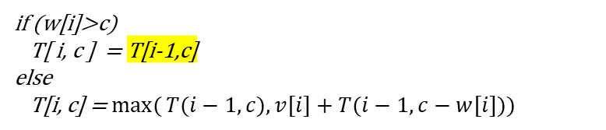
Knapsack simulation
Assume,
Sack capacity, C = 10
Available Items
V = 7 2 1 6 12
W =3 1 2 4 6
if (w[i]>c)
T[ i, c ] = T[i-1,c]
else
T[i, c] = $\max{(}T(i−1, c),v[i]+T(i−1, c−w[i]))$
i | v_{i} | w_{i} | 0 | 1 | 2 | 3 | 4 | 5 | 6 | 7 | 8 | 9 | 10
0 | 0 | 0 | 0 | 0 | 0 | 0 | 0 | 0 | 0 | 0 | 0 | 0 | 0
1 | 2 | 1 | 0 | 2 | 2 | 2 | 2 | 2 | 2 | 2 | 2 | 2 | 2
2 | 1 | 2 | 0
3 | 7 | 3 | 0
4 | 6 | 4 | 0
5 | 12 | 6 | 0
Capacity
T(2,1)= T[2-1,1] as w₂ > c
= T[1,1] = 2

Slide 43
Knapsack simulation
Assume,
Sack capacity, C = 10
Available Items
V = 7 2 1 6 12
W =3 1 2 4 6
if (w[i]>c)
T[ i, c ] = T[i-1,c]
else
T[i, c] = $\max{(}T(i−1, c),v[i]+T(i−1, c−w[i]))$
i | v_{i} | w_{i} | 0 | 1 | 2 | 3 | 4 | 5 | 6 | 7 | 8 | 9 | 10
0 | 0 | 0 | 0 | 0 | 0 | 0 | 0 | 0 | 0 | 0 | 0 | 0 | 0
1 | 2 | 1 | 0 | 2 | 2 | 2 | 2 | 2 | 2 | 2 | 2 | 2 | 2
2 | 1 | 2 | 0 | 2
3 | 7 | 3 | 0
4 | 6 | 4 | 0
5 | 12 | 6 | 0
Capacity
T(2,1)= T[2-1,1] as w₂ > c
= T[1,1] = 2

Slide 44
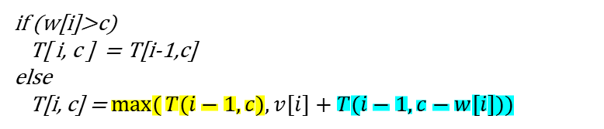
Knapsack simulation
Assume,
Sack capacity, C = 10
Available Items
V = 7 2 1 6 12
W =3 1 2 4 6
if (w[i]>c)
T[ i, c ] = T[i-1,c]
else
T[i, c] = $\max{(}T(i−1, c),v[i]+T(i−1, c−w[i]))$
i | v_{i} | w_{i} | 0 | 1 | 2 | 3 | 4 | 5 | 6 | 7 | 8 | 9 | 10
0 | 0 | 0 | 0 | 0 | 0 | 0 | 0 | 0 | 0 | 0 | 0 | 0 | 0
1 | 2 | 1 | 0 | 2 | 2 | 2 | 2 | 2 | 2 | 2 | 2 | 2 | 2
2 | 1 | 2 | 0 | 2
3 | 7 | 3 | 0
4 | 6 | 4 | 0
5 | 12 | 6 | 0
Capacity
Going w₂ cell back
T[2,2] = Max(T[2-1,2], v₂ + T[1-1, 2-2])
= Max( T[1,2], 1 + T[1,0])
= Max(2, 1) = 2

Slide 45
Knapsack simulation
Assume,
Sack capacity, C = 10
Available Items
V = 7 2 1 6 12
W =3 1 2 4 6
if (w[i]>c)
T[ i, c ] = T[i-1,c]
else
T[i, c] = $\max{(}T(i−1, c),v[i]+T(i−1, c−w[i]))$
i | v_{i} | w_{i} | 0 | 1 | 2 | 3 | 4 | 5 | 6 | 7 | 8 | 9 | 10
0 | 0 | 0 | 0 | 0 | 0 | 0 | 0 | 0 | 0 | 0 | 0 | 0 | 0
1 | 2 | 1 | 0 | 2 | 2 | 2 | 2 | 2 | 2 | 2 | 2 | 2 | 2
2 | 1 | 2 | 0 | 2 | 2
3 | 7 | 3 | 0
4 | 6 | 4 | 0
5 | 12 | 6 | 0
Capacity
T[2,2] = 2

Slide 46
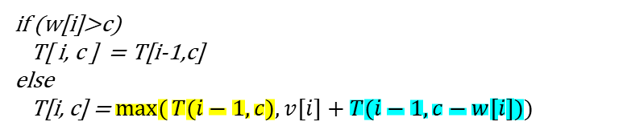
Knapsack simulation
Assume,
Sack capacity, C = 10
Available Items
V = 7 2 1 6 12
W =3 1 2 4 6
if (w[i]>c)
T[ i, c ] = T[i-1,c]
else
T[i, c] = $\max{(}T(i−1, c),v[i]+T(i−1, c−w[i]))$
i | v_{i} | w_{i} | 0 | 1 | 2 | 3 | 4 | 5 | 6 | 7 | 8 | 9 | 10
0 | 0 | 0 | 0 | 0 | 0 | 0 | 0 | 0 | 0 | 0 | 0 | 0 | 0
1 | 2 | 1 | 0 | 2 | 2 | 2 | 2 | 2 | 2 | 2 | 2 | 2 | 2
2 | 1 | 2 | 0 | 2 | 2
3 | 7 | 3 | 0
4 | 6 | 4 | 0
5 | 12 | 6 | 0
Capacity
Going w₂ cell back
T[2,3] = Max( T[2-1, 3], v₂ + T[2-1, 3-2])
= Max( T[1,3], 1+ T[1,1])
= Max(2, 3) = 3

Slide 47
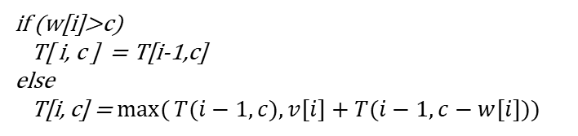
Knapsack simulation
Assume,
Sack capacity, C = 10
Available Items
V = 7 2 1 6 12
W =3 1 2 4 6
if (w[i]>c)
T[ i, c ] = T[i-1,c]
else
T[i, c] = $\max{(}T(i−1, c),v[i]+T(i−1, c−w[i]))$
i | v_{i} | w_{i} | 0 | 1 | 2 | 3 | 4 | 5 | 6 | 7 | 8 | 9 | 10
0 | 0 | 0 | 0 | 0 | 0 | 0 | 0 | 0 | 0 | 0 | 0 | 0 | 0
1 | 2 | 1 | 0 | 2 | 2 | 2 | 2 | 2 | 2 | 2 | 2 | 2 | 2
2 | 1 | 2 | 0 | 2 | 2 | 3 | 3 | 3 | 3 | 3 | 3 | 3 | 3
3 | 7 | 3 | 0 | 2 | 2 | 7 | 9 | 9 | 10 | 10 | 10 | 10 | 10
4 | 6 | 4 | 0 | 2 | 2 | 7 | 9 | 9 | 10 | 13 | 15 | 15 | 16
5 | 12 | 6 | 0 | 2 | 2 | 7 | 9 | 9 | 12 | 14 | 15 | 19 | 21
Capacity
So, simplest version is compare 1) the cell above the current cell and 2) v_{i} + value of w_{i} cell backward in previous row. Populate the current cell with whichever value is bigger.
Populate the table with this logic.

Slide 48
Knapsack simulation
How to find the items that are in the bag?
i | v_{i} | w_{i} | 0 | 1 | 2 | 3 | 4 | 5 | 6 | 7 | 8 | 9 | 10
0 | 0 | 0 | 0 | 0 | 0 | 0 | 0 | 0 | 0 | 0 | 0 | 0 | 0
1 | 2 | 1 | 0 | 2 | 2 | 2 | 2 | 2 | 2 | 2 | 2 | 2 | 2
2 | 1 | 2 | 0 | 2 | 2 | 3 | 3 | 3 | 3 | 3 | 3 | 3 | 3
3 | 7 | 3 | 0 | 2 | 2 | 7 | 9 | 9 | 10 | 10 | 10 | 10 | 10
4 | 6 | 4 | 0 | 2 | 2 | 7 | 9 | 9 | 10 | 13 | 15 | 15 | 16
5 | 12 | 6 | 0 | 2 | 2 | 7 | 9 | 9 | 12 | 14 | 15 | 19 | 21
Capacity

Slide 49
Knapsack simulation
How to find the items that are in the bag?
i | v_{i} | w_{i} | 0 | 1 | 2 | 3 | 4 | 5 | 6 | 7 | 8 | 9 | 10
0 | 0 | 0 | 0 | 0 | 0 | 0 | 0 | 0 | 0 | 0 | 0 | 0 | 0
1 | 2 | 1 | 0 | 2 | 2 | 2 | 2 | 2 | 2 | 2 | 2 | 2 | 2
2 | 1 | 2 | 0 | 2 | 2 | 3 | 3 | 3 | 3 | 3 | 3 | 3 | 3
3 | 7 | 3 | 0 | 2 | 2 | 7 | 9 | 9 | 10 | 10 | 10 | 10 | 10
4 | 6 | 4 | 0 | 2 | 2 | 7 | 9 | 9 | 10 | 13 | 15 | 15 | 16
5 | 12 | 6 | 0 | 2 | 2 | 7 | 9 | 9 | 12 | 14 | 15 | 19 | 21
Capacity

Slide 50
Knapsack simulation
How to find the items that are in the bag?
i | v_{i} | w_{i} | 0 | 1 | 2 | 3 | 4 | 5 | 6 | 7 | 8 | 9 | 10
0 | 0 | 0 | 0 | 0 | 0 | 0 | 0 | 0 | 0 | 0 | 0 | 0 | 0
1 | 2 | 1 | 0 | 2 | 2 | 2 | 2 | 2 | 2 | 2 | 2 | 2 | 2
2 | 1 | 2 | 0 | 2 | 2 | 3 | 3 | 3 | 3 | 3 | 3 | 3 | 3
3 | 7 | 3 | 0 | 2 | 2 | 7 | 9 | 9 | 10 | 10 | 10 | 10 | 10
4 | 6 | 4 | 0 | 2 | 2 | 7 | 9 | 9 | 10 | 13 | 15 | 15 | 16
5 | 12 | 6 | 0 | 2 | 2 | 7 | 9 | 9 | 12 | 14 | 15 | 19 | 21
Capacity
Sack = {}
1. Start with 21 (Green cell) and compare with the one above it (16).
2. As 21 and 16 are not equal item# 5 is included in the sack.
3. Go 6(weight if item) units back in previous row which is the next cell to check.

Slide 51
Knapsack simulation
How to find the items that are in the bag?
i | v_{i} | w_{i} | 0 | 1 | 2 | 3 | 4 | 5 | 6 | 7 | 8 | 9 | 10
0 | 0 | 0 | 0 | 0 | 0 | 0 | 0 | 0 | 0 | 0 | 0 | 0 | 0
1 | 2 | 1 | 0 | 2 | 2 | 2 | 2 | 2 | 2 | 2 | 2 | 2 | 2
2 | 1 | 2 | 0 | 2 | 2 | 3 | 3 | 3 | 3 | 3 | 3 | 3 | 3
3 | 7 | 3 | 0 | 2 | 2 | 7 | 9 | 9 | 10 | 10 | 10 | 10 | 10
4 | 6 | 4 | 0 | 2 | 2 | 7 | 9 | 9 | 10 | 13 | 15 | 15 | 16
5 | 12 | 6 | 0 | 2 | 2 | 7 | 9 | 9 | 12 | 14 | 15 | 19 | 21
Capacity
included
Sack = {5}

Slide 52
Knapsack simulation
How to find the items that are in the bag?
i | v_{i} | w_{i} | 0 | 1 | 2 | 3 | 4 | 5 | 6 | 7 | 8 | 9 | 10
0 | 0 | 0 | 0 | 0 | 0 | 0 | 0 | 0 | 0 | 0 | 0 | 0 | 0
1 | 2 | 1 | 0 | 2 | 2 | 2 | 2 | 2 | 2 | 2 | 2 | 2 | 2
2 | 1 | 2 | 0 | 2 | 2 | 3 | 3 | 3 | 3 | 3 | 3 | 3 | 3
3 | 7 | 3 | 0 | 2 | 2 | 7 | 9 | 9 | 10 | 10 | 10 | 10 | 10
4 | 6 | 4 | 0 | 2 | 2 | 7 | 9 | 9 | 10 | 13 | 15 | 15 | 16
5 | 12 | 6 | 0 | 2 | 2 | 7 | 9 | 9 | 12 | 14 | 15 | 19 | 21
Capacity
Not Included
Included
Weight Left: 10-6=4
Sack = {5}
1. Compare T[4,4] 9 (Green cell) with the one above it (9).
2. As both cell has same value item# 4 is not included in the sack.

Slide 53
Knapsack simulation
How to find the items that are in the bag?
i | v_{i} | w_{i} | 0 | 1 | 2 | 3 | 4 | 5 | 6 | 7 | 8 | 9 | 10
0 | 0 | 0 | 0 | 0 | 0 | 0 | 0 | 0 | 0 | 0 | 0 | 0 | 0
1 | 2 | 1 | 0 | 2 | 2 | 2 | 2 | 2 | 2 | 2 | 2 | 2 | 2
2 | 1 | 2 | 0 | 2 | 2 | 3 | 3 | 3 | 3 | 3 | 3 | 3 | 3
3 | 7 | 3 | 0 | 2 | 2 | 7 | 9 | 9 | 10 | 10 | 10 | 10 | 10
4 | 6 | 4 | 0 | 2 | 2 | 7 | 9 | 9 | 10 | 13 | 15 | 15 | 16
5 | 12 | 6 | 0 | 2 | 2 | 7 | 9 | 9 | 12 | 14 | 15 | 19 | 21
Capacity
Included
Not Included
Included
Sack = {5, 3}
1. Compare T[3,4] 9 (Green cell) with the one above it (3).
2. As the cells have different values item# 3 is included in the sack.
3. Go 3 units back in previous row which is the next cell to check.

Slide 54
Knapsack simulation
How to find the items that are in the bag?
i | v_{i} | w_{i} | 0 | 1 | 2 | 3 | 4 | 5 | 6 | 7 | 8 | 9 | 10
0 | 0 | 0 | 0 | 0 | 0 | 0 | 0 | 0 | 0 | 0 | 0 | 0 | 0
1 | 2 | 1 | 0 | 2 | 2 | 2 | 2 | 2 | 2 | 2 | 2 | 2 | 2
2 | 1 | 2 | 0 | 2 | 2 | 3 | 3 | 3 | 3 | 3 | 3 | 3 | 3
3 | 7 | 3 | 0 | 2 | 2 | 7 | 9 | 9 | 10 | 10 | 10 | 10 | 10
4 | 6 | 4 | 0 | 2 | 2 | 7 | 9 | 9 | 10 | 13 | 15 | 15 | 16
5 | 12 | 6 | 0 | 2 | 2 | 7 | 9 | 9 | 12 | 14 | 15 | 19 | 21
Capacity
Not Included
Included
Not Included
Included
Weight Left: 4-3=1
Sack = {5, 3}
1. Compare T[2,1] 2 (Green cell) with the one above it (2).
2. As both cells have same values item# 2 is not included in the sack.

Slide 55
Knapsack simulation
How to find the items that are in the bag?
i | v_{i} | w_{i} | 0 | 1 | 2 | 3 | 4 | 5 | 6 | 7 | 8 | 9 | 10
0 | 0 | 0 | 0 | 0 | 0 | 0 | 0 | 0 | 0 | 0 | 0 | 0 | 0
1 | 2 | 1 | 0 | 2 | 2 | 2 | 2 | 2 | 2 | 2 | 2 | 2 | 2
2 | 1 | 2 | 0 | 2 | 2 | 3 | 3 | 3 | 3 | 3 | 3 | 3 | 3
3 | 7 | 3 | 0 | 2 | 2 | 7 | 9 | 9 | 10 | 10 | 10 | 10 | 10
4 | 6 | 4 | 0 | 2 | 2 | 7 | 9 | 9 | 10 | 13 | 15 | 15 | 16
5 | 12 | 6 | 0 | 2 | 2 | 7 | 9 | 9 | 12 | 14 | 15 | 19 | 21
Capacity
Included
Not Included
Included
Not Included
Included
Weight Left: 1-1=0
Sack = {5, 3, 1}
1. Compare T[1,1] 2 (Green cell) with the one above it (0).
2. As the cells have different values item# 1 is included in the sack.

Slide 56
Knapsack simulation
How to find the items that are in the bag?
i | v_{i} | w_{i} | 0 | 1 | 2 | 3 | 4 | 5 | 6 | 7 | 8 | 9 | 10
0 | 0 | 0 | 0 | 0 | 0 | 0 | 0 | 0 | 0 | 0 | 0 | 0 | 0
1 | 2 | 1 | 0 | 2 | 2 | 2 | 2 | 2 | 2 | 2 | 2 | 2 | 2
2 | 1 | 2 | 0 | 2 | 2 | 3 | 3 | 3 | 3 | 3 | 3 | 3 | 3
3 | 7 | 3 | 0 | 2 | 2 | 7 | 9 | 9 | 10 | 10 | 10 | 10 | 10
4 | 6 | 4 | 0 | 2 | 2 | 7 | 9 | 9 | 10 | 13 | 15 | 15 | 16
5 | 12 | 6 | 0 | 2 | 2 | 7 | 9 | 9 | 12 | 14 | 15 | 19 | 21
Capacity
Included
Not Included
Included
Not Included
Included
Sack = {5, 3, 1}
As we have reached the 0th row, we are done with item selection. So, the sack contains 1, 3 and 5 item with value = 2+7+12 = 21

Slide 57
Knapsack simulation
for (int i = 1; i <= n; i++)
{
for (int j = 0; j <= cpt; j++)
{
if(wt[i-1]<=j)
dp[i][j]=max((val[i-1]+dp[i - 1][j - wt[i - 1]]),dp[i-1][j]);
else
dp[i][j] = dp[i-1][j];
}
}
printf("Max Value: %d",dp[n][cpt]);

Slide 58
Knapsack space optimized simulation
int knapSack(int cpt, int wt[], int val[], int n)
{
int dp[cpt + 1];
memset(dp, 0, sizeof(dp));
for (int i=0; i<n; i++)
for (int j=0; j<=cpt; j++)
if (wt[i - 1] <= j)
dp[j] = max(dp[j],dp[j - wt[i - 1]] + val[i - 1]);
return dp[cpt];
}

Slide 59
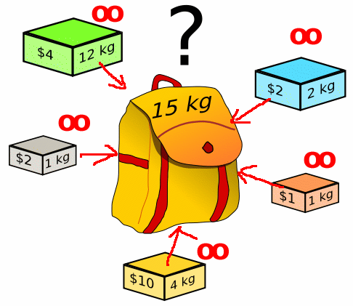
Unbounded Knapsack (Repetition of items allowed)

Slide 60
Knapsack Unbounded
Given a knapsack weight W and a set of n items with certain value val_{i} and weight wt_{i}, we need to calculate the maximum amount that could make up this quantity exactly.
This is different from classical Knapsack problem, here we are allowed to use unlimited number of instances of an item.

Slide 61
Knapsack Unbounded
Example:
items: {Apple, Orange, Melon}
weights: {1, 2, 3}
profits: {15, 20, 50}
capacity: 5
Different Profit Combinations:
5 Apples (total weight 5) => 75 profit
1 Apple + 2 Oranges (total weight 5) => 55 profit
3 Apples + 1 Orange (total weight 5) => 65 profit
2 Apples + 1 Melon (total weight 5) => 80 profit
1 Orange + 1 Melon (total weight 5) => 70 profit
Best Profit Combination : 2 Apples + 1 Melon with 80 profit.

Slide 62
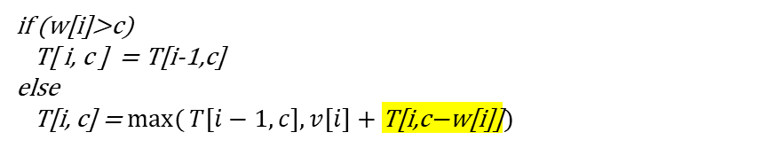
Knapsack simulation - Unbounded
Can include multiple instances of the same resource
i | v_{i} | w_{i} | 0 | 1 | 2 | 3 | 4 | 5 | 6 | 7 | 8 | 9 | 10
0 | 0 | 0 | 0 | 0 | 0 | 0 | 0 | 0 | 0 | 0 | 0 | 0 | 0
1 | 2 | 1 | 0
2 | 1 | 2 | 0
3 | 7 | 3 | 0
4 | 6 | 4 | 0
5 | 12 | 6 | 0
Capacity
if (w[i]>c)
T[ i, c ] = T[i-1,c]
else
T[i, c] = $\max{(}T[i−1, c],v[i]+\text{T}\text{[}\text{i}\text{,}\text{c}\text{−}\text{w}\text{[}\text{i}\text{]]})$

Slide 63
Knapsack simulation - Unbounded
Can include multiple instances of the same resource
i | v_{i} | w_{i} | 0 | 1 | 2 | 3 | 4 | 5 | 6 | 7 | 8 | 9 | 10
0 | 0 | 0 | 0 | 0 | 0 | 0 | 0 | 0 | 0 | 0 | 0 | 0 | 0
1 | 2 | 1 | 0 | 2 | 4 | 6 | 8 | 10 | 12 | 14 | 16 | 18 | 20
2 | 1 | 2 | 0 | 2 | 4 | 6 | 8 | 10 | 12 | 14 | 16 | 18 | 20
3 | 7 | 3 | 0 | 2 | 4 | 7 | 9 | 11 | 14 | 16 | 18 | 21 | 23
4 | 6 | 4 | 0 | 2 | 2 | 7 | 9 | 11 | 14 | 16 | 18 | 21 | 23
5 | 12 | 6 | 0 | 2 | 2 | 7 | 9 | 11 | 14 | 16 | 18 | 21 | 23
Capacity
if (w[i]>c)
T[ i, c ] = T[i-1,c]
else
T[i, c] = $\max{(}T[i−1, c],v[i]+\text{T}\text{[}\text{i}\text{,}\text{c}\text{−}\text{w}\text{[}\text{i}\text{]]})$

Slide 64
Knapsack simulation - Unbounded
How to find the items that are in the bag?
i | v_{i} | w_{i} | 0 | 1 | 2 | 3 | 4 | 5 | 6 | 7 | 8 | 9 | 10
0 | 0 | 0 | 0 | 0 | 0 | 0 | 0 | 0 | 0 | 0 | 0 | 0 | 0
1 | 2 | 1 | 0 | 2 | 4 | 6 | 8 | 10 | 12 | 14 | 16 | 18 | 20
2 | 1 | 2 | 0 | 2 | 4 | 6 | 8 | 10 | 12 | 14 | 16 | 18 | 20
3 | 7 | 3 | 0 | 2 | 4 | 7 | 9 | 11 | 14 | 16 | 18 | 21 | 23
4 | 6 | 4 | 0 | 2 | 2 | 7 | 9 | 11 | 14 | 16 | 18 | 21 | 23
5 | 12 | 6 | 0 | 2 | 2 | 7 | 9 | 11 | 14 | 16 | 18 | 21 | 23
Capacity
Not Included
Included – 1 times
Not Included
Included – 3 times
Not Included
Not Included
Sack = {3, 3, 3, 1}
As we have reached the 0th row, we are done with item selection. So, the sack contains one quantity of item#1 and 3 quantity of item#3 with value = 1*2+3*7 = 23

Slide 65
Knapsack simulation - Unbounded
for (int i = 1; i <= n; i++)
{
for (int j = 0; j <= cpt; j++)
{
if(wt[i-1]<=j)
dp[i][j]=max((val[i-1]+dp[i][j - wt[i - 1]]),dp[i-1][j]);
else
dp[i][j] = dp[i-1][j];
printf("%d ",dp[i][j]);
}
printf("\n");
}

Slide 66
Coin changing problem

Slide 67
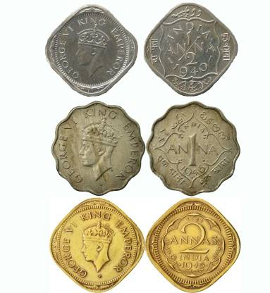
Coin Changing Problem
The problem states that “given a set of coins with several values, it is required to make a change using those coins for a particular amount of cents using the minimum number of coins”.

Slide 68
What is the solution?
Using dynamic programming:
bottom up manner:
re-computations of same subproblems can be avoided by constructing a temporary array table[][]

Slide 69
int minCoins(int coins[], int m, int V)
{
int table[V+1];
table[0] = 0;
for (int i=1; i<=V; i++)
table[i] = INT_MAX;
for (int i=1; i<=V; i++)
{
for (int j=0; j<m; j++)
if (coins[j] <= i)
{
int sub_res = table[i-coins[j]];
table[i] = min(table[i], 1 + sub_res);
}
}
if(table[V]==INT_MAX)
return -1;
return table[V];
}
m=number of different coins
V= changing value
table[i] will be storing the minimum number of coins required for i value
Initialize all table values as Infinite
Compute minimum coins required for all values from 1 to V
Add min coins in the table
The time complexity of the above solution is O(m*V).

Slide 70
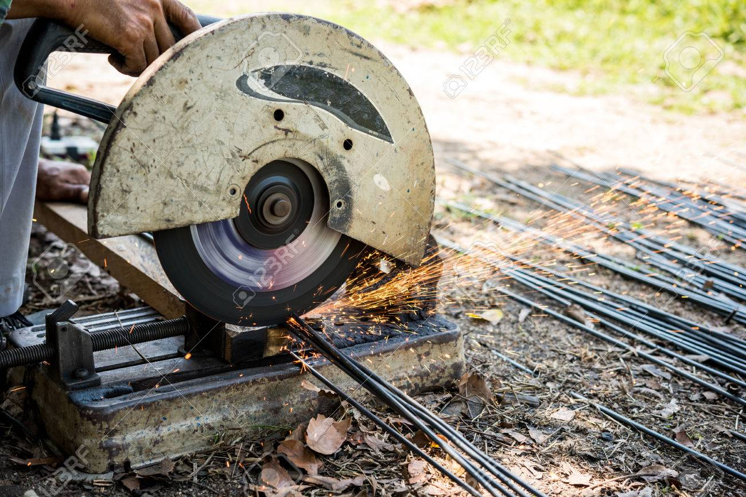
Rod-cutting problem

Slide 71
Rod cutting problem
Given
a rod of length n inches and
an array of prices that contains prices of all pieces of size smaller than n.
Determine
the maximum value obtainable by cutting up the rod and selling the pieces.

Slide 72

Example
Length | 1 | 2 | 3 | 4 | 5 | 6 | 7 | 8 | 9 | 10
Price | 1 | 5 | 8 | 9 | 10 | 17 | 17 | 20 | 24 | 30
Assume you have a rod of length 4 inch.
A table that shows the price of all different length of rod.
How can we cut the rod so that we can maximize the profit?

Slide 73






Example cont..
Length | 1 | 2 | 3 | 4 | 5 | 6 | 7 | 8 | 9 | 10
Price | 1 | 5 | 8 | 9 | 10 | 17 | 17 | 20 | 24 | 30
Possible combinations:

Slide 74
Brute Force approach
#include<bits/stdc++.h>
using namespace std;
int rodCutting(int price[], int len)
{
if(len<=0)
return 0;
int max_len=INT_MIN;
for(int i=0; i<len; i++)
{
max_len = max(max_len, price[i] + rodCutting(price, len-(i+1)));
}
return max_len;
}
int main(){
int price[10] = {1,5,8,9,10,17,17,20,24,30};
int rod_len=4;
cout<<rodCutting(price,rod_len,10)<<'\n";
}

Slide 75
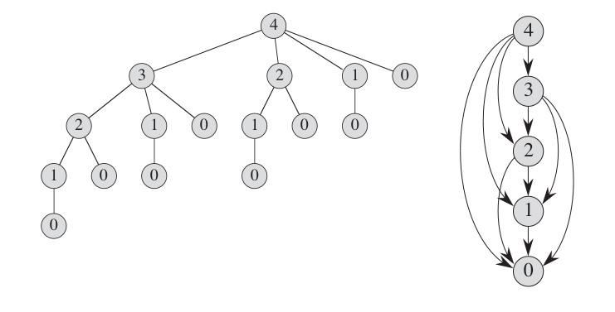
Brute Force
The recursion tree shows a recursive call resulting from rodCutting(price,4).
This figure clearly explains why the computation time for the algorithm is so ridiculous. We keep calling the function again and again even though the result has already been calculated.
For example rodCutting(1) has been calculated 4 times. In order to avoid that we use dynamic programming.

Slide 76
Rod Cutting Using DP
The idea is same as the previous approach with the only difference that the values of max_price(N-i) in:
price[i] + max_price(N - i)
are precomputed and stored in an array.
This removes all duplicate calls and optimizes our solution greatly.

Slide 77
DP solution- 1 inch rod
Length | 1 | 2 | 3 | 4 | 5 | 6 | 7 | 8 | 9 | 10
Price | 1 | 5 | 8 | 9 | 10 | 17 | 17 | 20 | 24 | 30
Opt. price

Slide 78

DP solution- 2 inch rod
Length | 1 | 2 | 3 | 4 | 5 | 6 | 7 | 8 | 9 | 10
Price | 1 | 5 | 8 | 9 | 10 | 17 | 17 | 20 | 24 | 30
Opt. price | 1
$$r_{2}=\max\left\{\begin{aligned}& \\ &p_{1}+r_{1}=1+1=2 \\ &p_{2}=5\end{aligned}\right. \\ =5$$

Slide 79
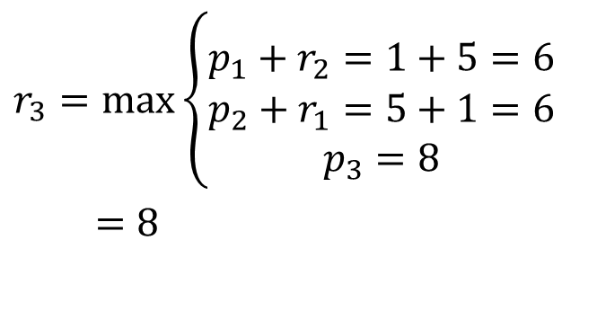
DP solution- 3 inch rod
Length | 1 | 2 | 3 | 4 | 5 | 6 | 7 | 8 | 9 | 10
Price | 1 | 5 | 8 | 9 | 10 | 17 | 17 | 20 | 24 | 30
Opt. price | 1 | 5
$$r_{3}=\max\left\{\begin{aligned}& \\ &p_{1}+r_{2}=1+5=6 \\ &p_{2}+r_{1}=5+1=6 \\ p_{3}=8\end{aligned}\right. \\ =8$$

Slide 80
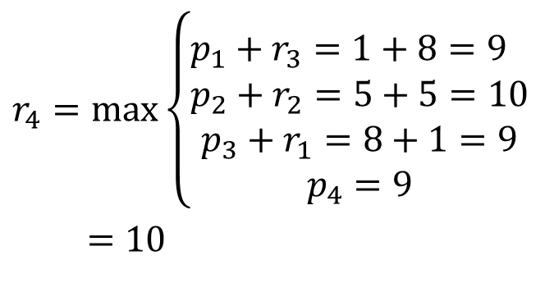
DP solution- 4 inch rod
Length | 1 | 2 | 3 | 4 | 5 | 6 | 7 | 8 | 9 | 10
Price | 1 | 5 | 8 | 9 | 10 | 17 | 17 | 20 | 24 | 30
Opt. price | 1 | 5 | 8
$$r_{4}=\max\left\{\begin{aligned}& \\ &p_{1}+r_{3}=1+8=9 \\ &p_{2}+r_{2}=5+5=10 \\ p_{3}+r_{1}=8+1=9 \\ p_{4}=9\end{aligned}\right. \\ =10$$

Slide 81
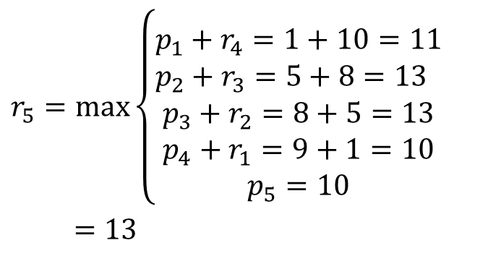
DP solution- 5 inch rod
Length | 1 | 2 | 3 | 4 | 5 | 6 | 7 | 8 | 9 | 10
Price | 1 | 5 | 8 | 9 | 10 | 17 | 17 | 20 | 24 | 30
Opt. price | 1 | 5 | 8 | 10
$$r_{5}=\max\left\{\begin{aligned}& \\ &p_{1}+r_{4}=1+10=11 \\ &p_{2}+r_{3}=5+8=13 \\ p_{3}+r_{2}=8+5=13 \\ p_{4}+r_{1}=9+1=10 \\ p_{5}=10\end{aligned}\right. \\ =13$$

Slide 82
DP solution- 6 to10 inch rod
Length | 1 | 2 | 3 | 4 | 5 | 6 | 7 | 8 | 9 | 10
Price | 1 | 5 | 8 | 9 | 10 | 17 | 17 | 20 | 24 | 30
Opt. price | 1 | 5 | 8 | 10 | 13 | 17 | 18 | 22 | 25 | 30
With similar calculation we can fill out the remaining table
r₆ -> 17 (no cut)
r₇ -> 18 (1+6 or 2+2+3 )
r₈ -> 22 (2+6 )
r₉ -> 25 (3+6 )
r₁₀ -> 30 (no cut)

Slide 83
Rod Cutting Using DP: bottom up manner
int rodCutting(int price[], int len)
{
int val[len+1];
val[0]=0;
int i,j;
for (i = 1; i<=len; i++)
{
int max_val = INT_MIN;
for (j = 0; j < i; j++)
max_val = max(max_val, price[j] + val[i-j-1]);
val[i] = max_val;
}
return val[len];
}
Time Complexity: O(n^2)
This time complexity is till better than the worse time complexity of the brute force approach.

Slide 84
Reference
Chapter 15 (15.1 and 15.3) (Cormen)
http://www.shafaetsplanet.com/?p=3638
https://www.javatpoint.com/0-1-knapsack-problem
https://www.geeksforgeeks.org/0-1-knapsack-problem-dp-10/

Slide 85
Lab Test: Up to Lab-7 (Greedy)
Section B2: 27
Section B1: 29
Section A2:

Slide 86

Thanks to All

